Slide 1
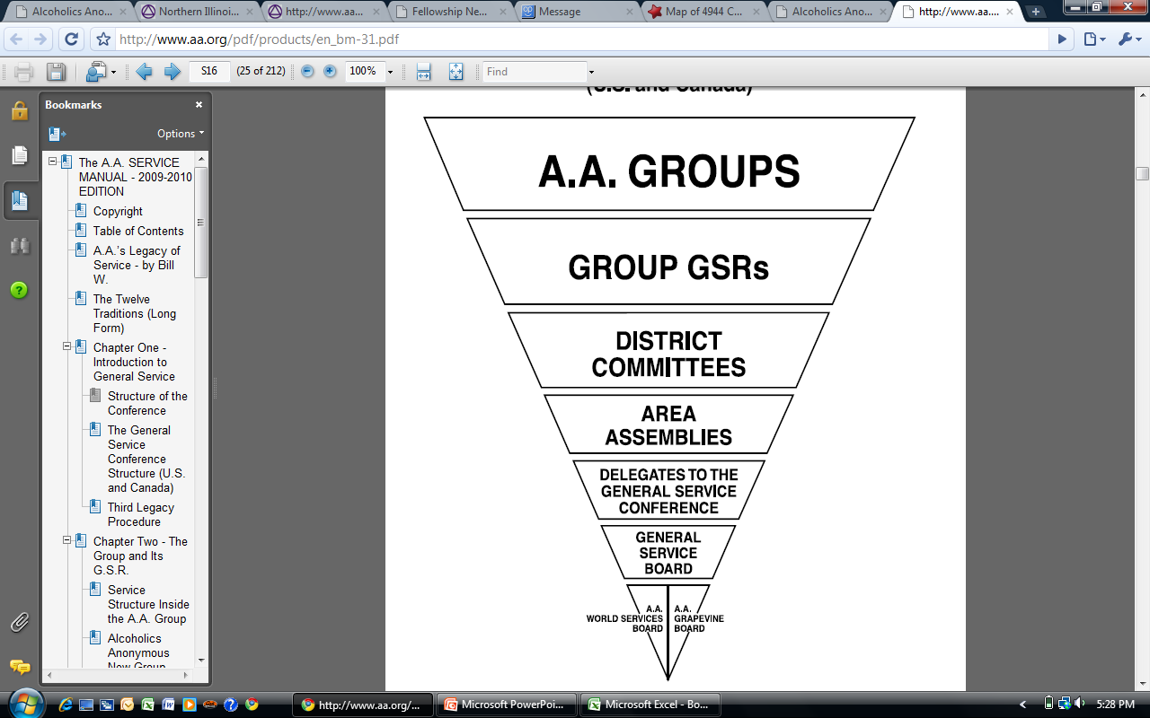
The A.A. group… where A.A.’s service structure begins

Slide 2

How the parts of AA all fit and work together to help the alcoholic who still suffers.

Slide 3
Tradition Two
For our group purpose there is but one ultimate authority – a loving God as he may express Himself in our groups conscience. Our leaders are but trusted servants; they do not govern.

Slide 4
Concept One
The final responsibility and ultimate authority for AA world services should always reside in the collective conscience of our whole Fellowship.

Slide 5
The A.A. group…
…where A.A.’s service structure begins
An A.A. meeting…
  …is a gathering of A.A.’s at a specified time and place
  …is generally concerned with A.A.’s program of recovery
An A.A. group…
  …is a spiritual entity that exists outside walls of the meeting room
    Members have frequent contact with other members
    Members perform service work together
  …is founded upon the Twelve Traditions of Alcoholics Anonymous

Slide 6
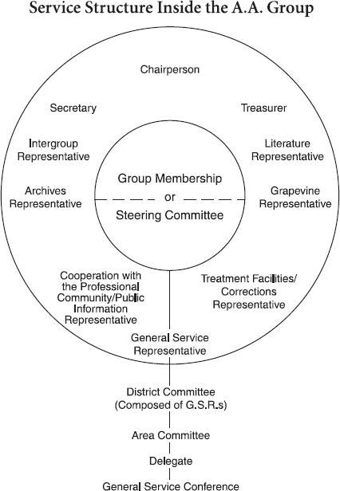

Slide 7
District
A division within the Area, represented by GSRs and District Committee Members.
District Committee Member (DCM)
Also known as a District Chair. An experienced GSR or committee member elected by other GSRs to represent the groups of their district in DCM committee meetings and to coordinate service activities in the district.

Slide 8
AREA
An area is a geographical division within a state or province. A Delegate to the General Service Conference is elected from an area assembly. Normally there is one area to a state or province, except in heavily AA-populated places, where there may be two, three, or more areas in a state or province. Some areas include portions of more than one state or province.
Delegate
The man or woman elected every other year to represent the area at the annual Conference meeting in New York and to bring back the results of that meeting to the area.

Slide 9
Pre-Conference Process
January 14th - Preliminary Agenda
February 15th - Final Agenda & Background Material
Distribution
  DCM
  Committee Chairs
  Anyone interested…
Pre-Conference Assembly & Workshop - April 8, 2017
  Committee meetings
  General Session

Slide 10
What is a Group informed Conscious
The competitive way permits the person with the loudest voice to push his ideas across, take a vote and come up with a ‘majority’ decision.
In the cooperative way, group members come together in mutual trust to arrive at a group decision, not one individual’s personal triumph.
This reminds us that Concept One states “The final responsibility for AA World Services should always reside in the collective conscience of our whole fellowship.”
Tradition Two: “For our Group purpose there is but one ultimate authority—a loving God as He may express Himself in our Group conscience. Our leaders are but trusted servants, they do not govern.

Slide 11
Suggested Steps to Achieving an Informed Group Conscience
GATHER KNOWLEDGE: The GSR or other chairperson of the group informs himself/herself about the topic to be discussed. Then:
    PRESENT TOPIC/ISSUE:
    SHARING:
    CONSENSUS:
    RECAP:

Slide 12
The Minority Opinion
In Alcoholics Anonymous, once a vote has been taken on a motion, the minority parties ALWAYS have the opportunity to speak from the floor. If someone in the majority (the winning side) would like to change their vote after the minority has spoken, it becomes a motion to reconsider which needs to have a second. It is then open to further discussion (if the original motion was open to discussion) before a new vote on the original motion is taken. It is not amendable and requires the same type of vote (majority or 2/3) as the original motion.

Slide 13
Concept Two
The General Service Conference of A.A. has become, for
nearly every practical purpose, the active voice and the
effective conscience of our whole Society in world affairs.
In 1948 Dr. Bob suffers from a fatal illness
  Becomes clear that Bill and Bob will not be around forever
  November 16th, 1950
April 1951 - First General Service Conference
  5 year experiment
  1955 Bill turns the Fellowship over to the groups
  The A.A. Groups now fulfill the role that the co-founders did

Slide 14
Who Makes Up the Conference?
93 Delegates
21 Trustees
  8 Regional
  2 At Large
  4 General Service
  7 Non-Alcoholic
2 A.A.W.S. and Grapevine Directors
16 G.S.O. and Grapevine Staff
Total - 134

Slide 15
General Service Board
There are 21 Trustees
  Fourteen Alcoholic (Class B)
    8 Regional
    2 At-Large
    4 General Service
      2 from A.A.W.S.
      2 from the Grapevine Board
  Seven Non-Alcoholic (Class A)
Trustees comprise the General Service Board
G.S.B. owns A.A.W.S. and the Grapevine
G.S.B. operates the General Service Office

Slide 16
General Service Office
Staff Positions
  Conference Coordinator
  Cooperation with the Professional Community
  Corrections
  Group Services
  International
  Literature
  Nominating
  Public Information
  Regional Forums
  Staff Coordinator
  Treatment Facilities

Slide 17
General Service Office
Services include:
  Group services
  International
  Loners & Internationalists
  Public Information
  Anonymity breaks
  Cooperation w/Professional community
  Self-support
Alcoholics Anonymous website
Files
Group records
Help for groups in treatment and correctional facilities
Regional Forums
Area, state and provincial conventions

Slide 18
Committee System
Conference Committees
Agenda
Cooperation with the Professional Community
Corrections
Finance
Grapevine
Literature
Policy and Admissions
Public Information
Report and Charter
Treatment and Accessibilities
Trustees
Archives
International Conventions and Regional Forums

Slide 19
Role of the delegate
Responsibility to serve the US/Canada Conference as a whole.
Voting member of Conference, brings to its deliberations the experiences and viewpoints of their own area.
After hearing all points of view and becoming fully informed during the conference, they vote in the best interests of A.A. as a whole.
Concept three – Right of decision.

Slide 20


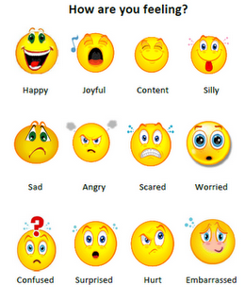
Reporting on the Conference
What I Saw
What I Heard
What I Felt
To be available to attend and present -
Area
Districts
Groups

Slide 21

Thank you for allowing me to serve you at the GSC
Questions

